Slide 1

HANGMAN OUT GAME
HARISH S

Slide 2
WHAT IS HANGMAN
In the Hangman game, one player thinks of a word, and the other player tries to guess it by suggesting letters. The word is initially represented by underscores, with each underscore corresponding to a letter in the word. The guessing player has a limited number of attempts to guess the correct letters. For each incorrect guess, a part of the “hangman” figure is drawn. The game continues until the guessing player either correctly guesses the word or runs out of attempts.

Slide 3
Here are the key components of the Hangman game:
Word Selection:
The game starts with the selection of a secret word (usually chosen from a predefined list).
The word is hidden from the guessing player, represented by underscores.
Guessing Mechanism:
The guessing player suggests a letter.
If the letter is in the word, all occurrences of that letter are revealed.
If the letter is not in the word, a part of the hangman figure is drawn (e.g., head, body, arms, legs).

Slide 4
Winning and Losing Conditions:
The guessing player wins if they correctly guess the entire word before the hangman figure is fully drawn.
The guessing player loses if the hangman figure is completed (i.e., all body parts are drawn).
Display:
Display the current state of the word (with underscores for unrevealed letters) and the hangman figure.
User Interaction:
The guessing player interacts by inputting letters.
The game provides feedback on whether the guessed letter is correct or incorrect.

Slide 5
Example:
Suppose the secret word is “APPLE.” The initial display would be “_ _ _ _ ," and the hangman figure would be empty. If the guessing player guesses “P,” the display becomes " P P _ _,” and no part of the hangman is drawn. If the next guess is “R,” the display remains the same, but a part of the hangman (e.g., the head) is drawn.

Slide 6
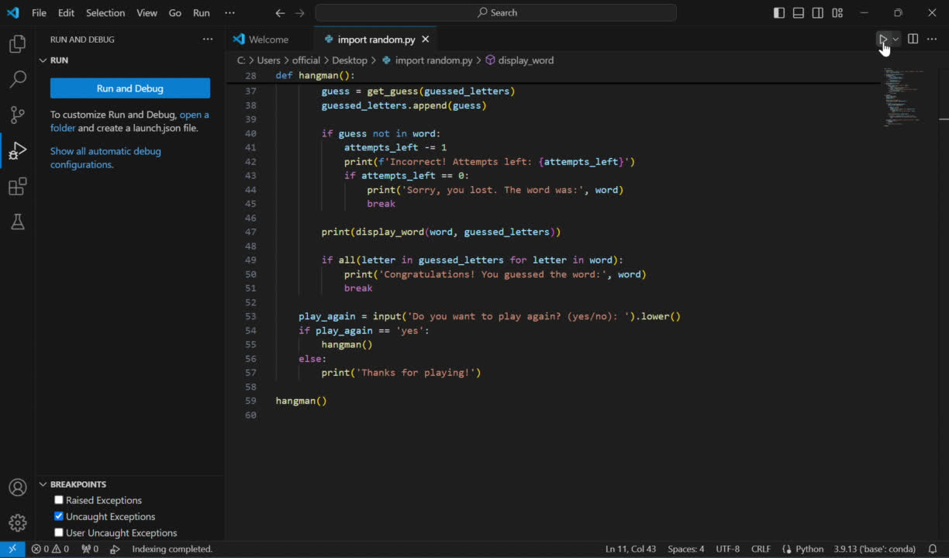

Slide 7
CODE:
Import random
def choose_word():
words = ['apple', 'banana', 'cherry', 'date', 'elderberry', 'fig', 'grape']
return random.choice(words)
def display_word(word, guessed_letters):
displayed_word = ''
for letter in word:
if letter in guessed_letters:
displayed_word += letter + ' '
else:
displayed_word += '_ '
return displayed_word.strip()

Slide 8
def get_guess(guessed_letters):
while True:
guess = input('Guess a letter: ').lower()
if len(guess) != 1:
print('Please enter a single letter.')
elif guess in guessed_letters:
print('You have already guessed that letter. Try again.')
elif not guess.isalpha():
print('Please enter a letter.')
else:
return guess
def hangman():
word = choose_word()
guessed_letters = []
attempts_left = 6
print('Welcome to Hangman!')
print(display_word(word, guessed_letters))

Slide 9
while True:
guess = get_guess(guessed_letters)
guessed_letters.append(guess)
if guess not in word:
attempts_left -= 1
print(f'Incorrect! Attempts left: {attempts_left}')
if attempts_left == 0:
print('Sorry, you lost. The word was:', word)
break
print(display_word(word, guessed_letters))
if all(letter in guessed_letters for letter in word):
print('Congratulations! You guessed the word:', word)
break
play_again = input('Do you want to play again? (yes/no): ').lower()
if play_again == 'yes':
hangman()
else:
print('Thanks for playing!')
hangman()

Slide 10
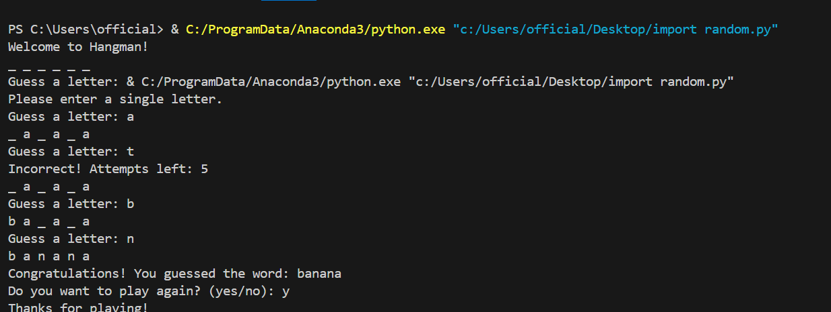
OUTPUT
WIN CASE:

Slide 11
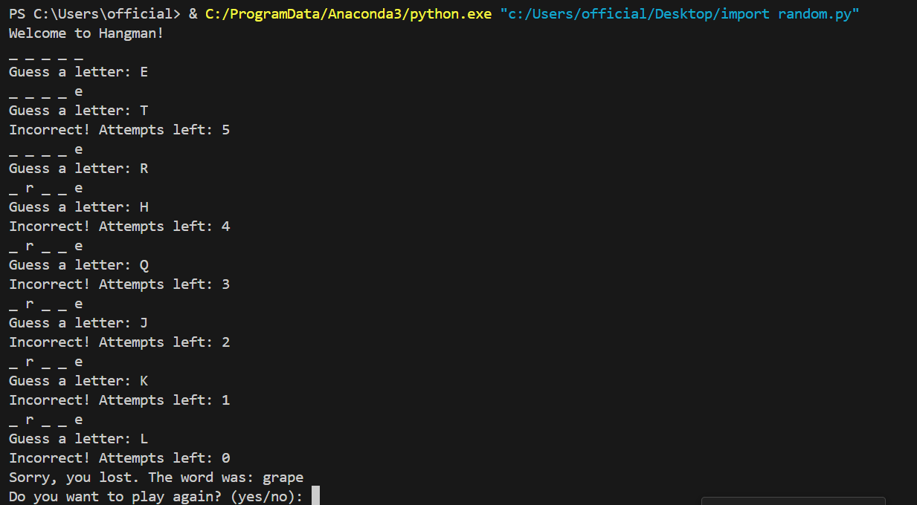
LOOSE CASE:

Slide 12
THANKYOU

